Slide 1
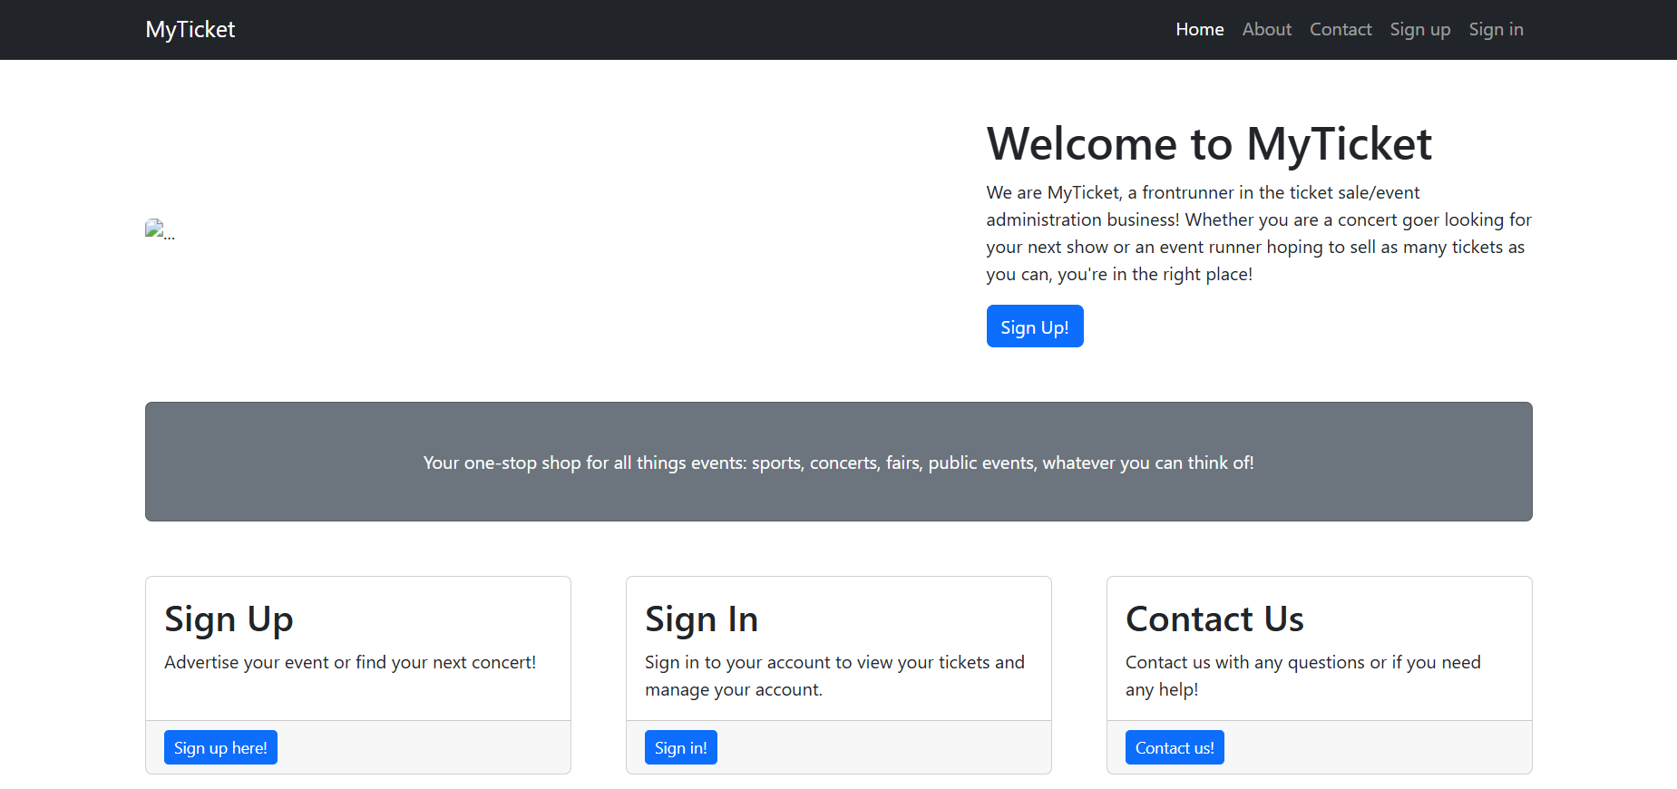
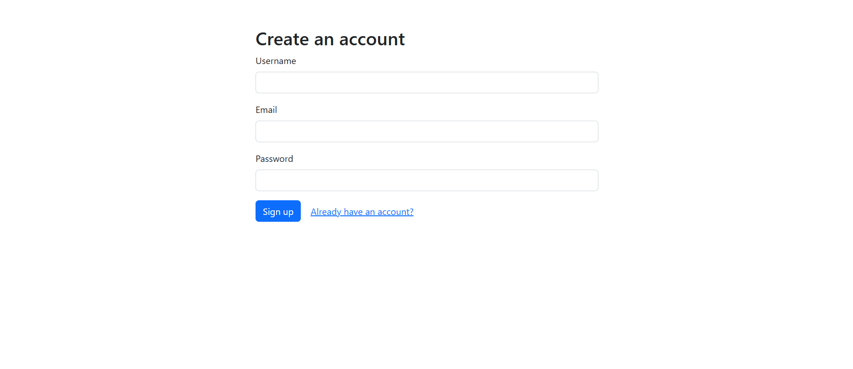
MyTicket
An event ticketing platform to rival sites like Ticketmaster.

Slide 2
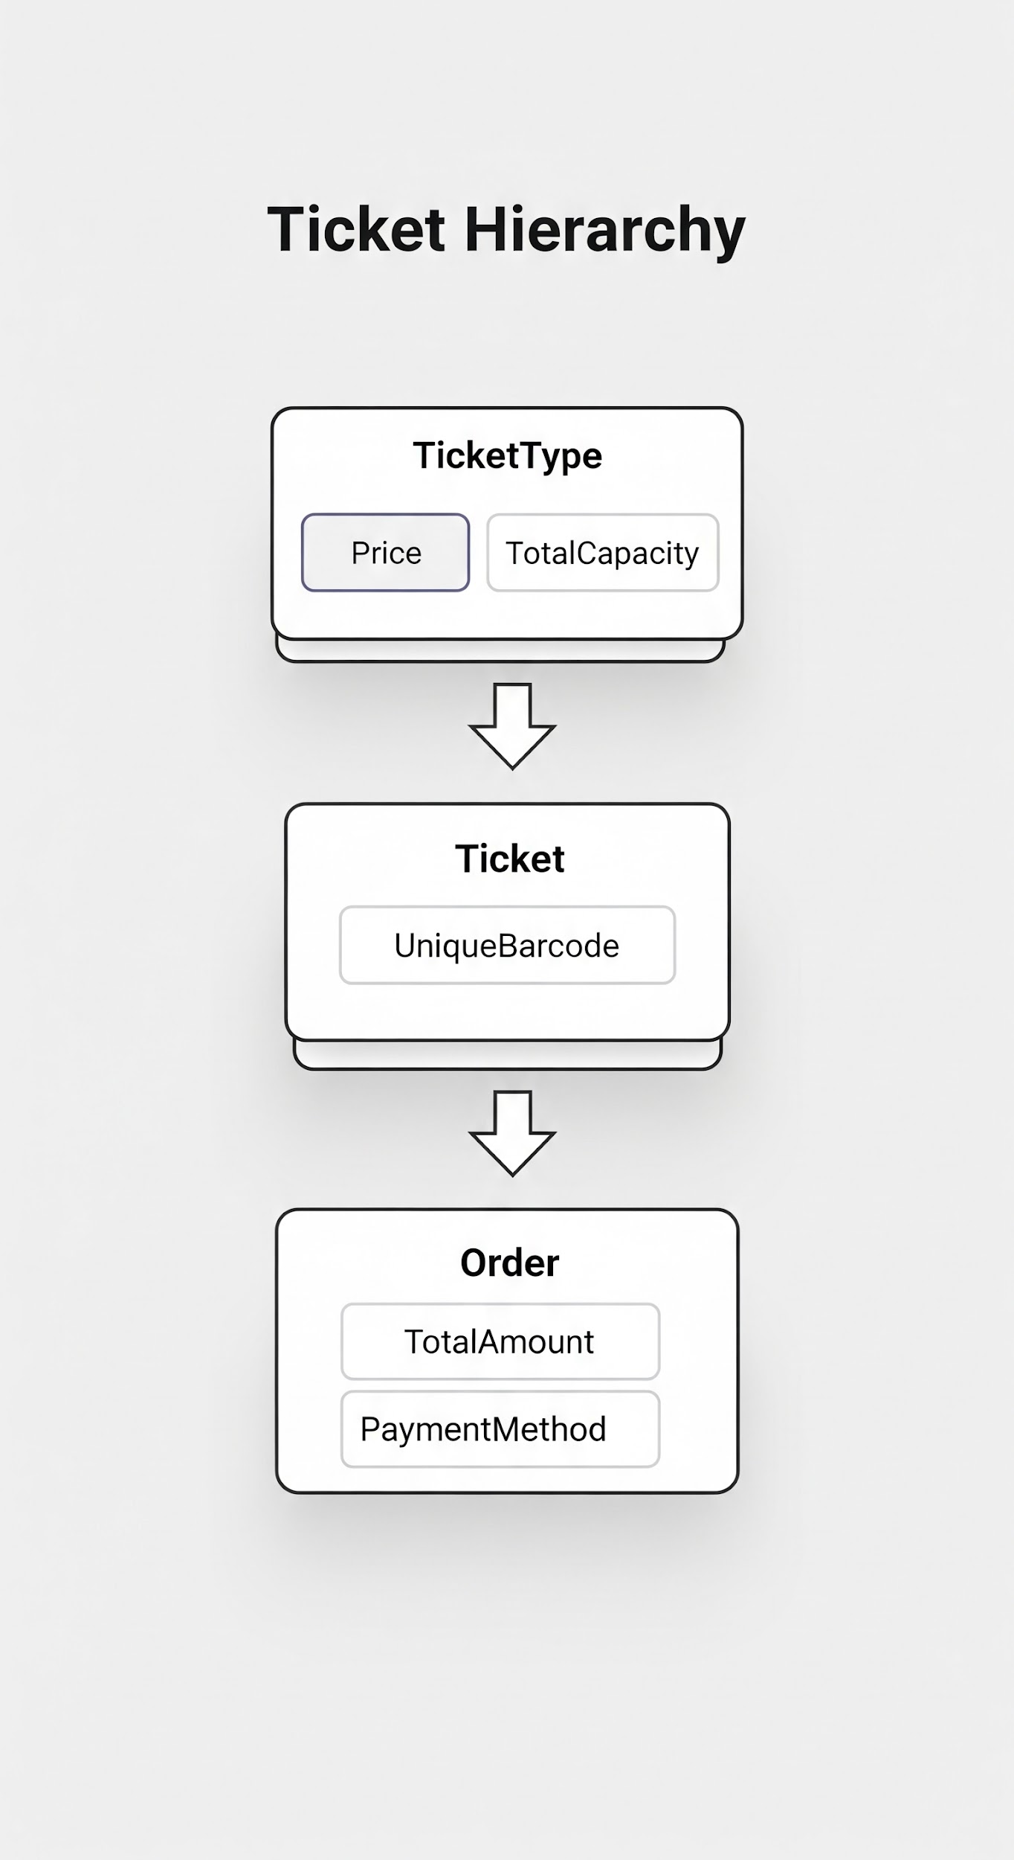
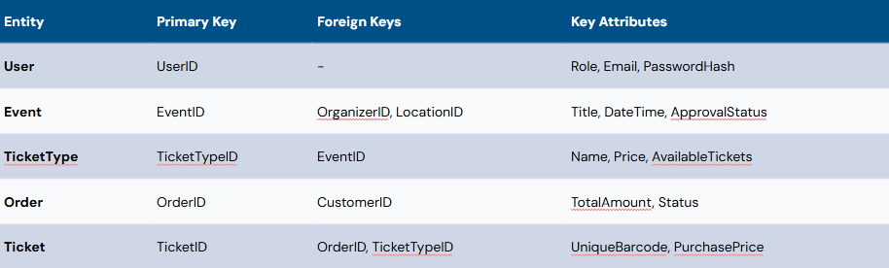
ERD

Slide 3
Team Contributions
Tyler: Static pages, presentation,

